Slide 1
H E X O R A
SPECIFICATION
& PROTOTYPE
Video games, digital and physical — P2 · Week 7
Motroc Cosmin Alexandru
Nica Rares-Octavian
Iordachescu Iulian Daniel
E-Commerce · 2026–2027
Catalog & admin lead
Payments & security lead
Accounts & shopping lead
P2 · Hexora
HEXORA · P2
1 / 15

Slide 2
STATUS SINCE P1
From a plan to a running store
The data model, component architecture and API surface are frozen. The three riskiest areas — catalog, accounts and payments — run against a seeded MySQL database.
13
32
9
3
tables in the frozen Prisma schema
purchasable editions from 16 games and 4 categories
test files, one command: npm test
branches, each with its own author and review
Frozen at P2
Working today
Next: weeks 8–12
ERD, endpoint list, wireframes, auth contract, payment service contract. Later changes need a written request.
A1 catalog, A2 search, A4 accounts, A10 groundwork, A6 webhook, admin/local MySQL setup, seed data.
A3 cart, A5 checkout, A7 stock UI, A8 history, A9 admin, A11 responsive, A12 full test suite, B4 + B5.
Why an edition is a product
The edition is the row that is sold: it carries its own price, stock, platform and format, while gameSlug links the digital and physical rows so a product page can offer the sibling edition.
Repo github.com/Iordachescu-Iulian/Project-E-commerce
Schema prisma/schema.prisma
Seed prisma/seed-products.ts
STATUS · P2
2 / 15

Slide 3
REQUIREMENTS A1–A4
Catalog, search, accounts
A1
A2
A3
A4
Product catalog
Basic search
Shopping cart
User accounts
Server-rendered paginated catalog (24/page), category pages and a product page with gallery, price, stock, platform and sibling edition.
Case-insensitive search on product names with filters in the URL and an explicit “No games found” state.
One cart per authenticated user; add, update, remove; server-recalculated totals; stock caps; persists after logout.
Register, login, logout, bcrypt hashes, signed httpOnly JWT and address CRUD with one default address.
● IMPLEMENTED
● IMPLEMENTED
● WEEKS 8–9
● IMPLEMENTED
What the demo proves
Server-side by design
4 categories · 16 games · 32 editions · 64 generated images, all read from MySQL at 127.0.0.1:3307. A missing cover falls back and a zero-stock edition is visibly out of stock.
Prisma is imported only in src/server/* and route handlers. Passwords never leave the server as hashes; the cookie is httpOnly, SameSite=Lax and signed with HS256.
Catalog src/app/(shop)/catalog · categories/[slug] · products/[slug]
Queries src/server/queries/catalog.ts
Seed prisma/seed-products.ts
Accounts src/lib/auth.ts · src/app/account
REQUIREMENTS · A1–A4
3 / 15

Slide 4
REQUIREMENTS A5–A8
Checkout, payment, stock and history
A5
A6
A7
A8
Checkout
Sandbox payment
Stock management
Order history
Address → delivery method (digital 0 lei, courier 19,99 lei) → server-validated summary → card payment, then a confirmation page.
Only a signed payment_intent.succeeded webhook marks an order Paid. A redirect never changes status; a failure stays Unpaid.
Conditional stock >= quantity decrement inside the paid transaction; rollback on conflict; cancellation restores stock once.
Customer order list and detail with date, items, total, payment state and status history.
● WEEKS 8–9
● WEBHOOK NOW
● SERVICE NOW
● WEEK 9
1 · Checkout
2 · PaymentIntent
3 · Webhook
4 · Confirmation
Server reloads the cart, validates stock, creates Order NEW / UNPAID.
Amount computed server-side; Stripe.js confirms the test card.
Signature verified, event stored once, order PAID, stock −qty, history appended.
Page reads the database; the redirect is never trusted.
Webhook src/app/api/webhooks/stripe/route.ts
Service src/server/services/payments.ts
Docs docs/payments.md · scripts/test-webhook.mjs
REQUIREMENTS · A5–A8
4 / 15

Slide 5
REQUIREMENTS A9–A12
Admin, security, responsive, tests
A9
A10
A11
A12
Administration panel
Basic security
Responsive design
Automated tests
Separate ADMIN role, product/category CRUD with image upload, order list by status and audited transitions New → Paid → Shipped → Delivered.
Zod validation, same-origin check on mutating routes, security headers, server-side role guards, Prisma parameterisation.
All customer pages usable at 360 px: 2-column grid on mobile, 4-column desktop, no horizontal scroll.
Vitest, one command. Payment confirmation, stock, auth, sessions, catalog and money covered; cart and totals join with A3.
● WEEKS 10–11
● GROUNDWORK NOW
● IMPLEMENTED
● GROWING
Why the split matters
What P3 will grade
A10 is not a UI concern: every route calls requireUser / requireRole and every mutating request passes assertSameOrigin before touching data.
Only working behaviour. The prototype already exercises the parts that are easy to fake: database reads, password hashing, cookie sessions, webhook signatures and stock transactions.
Security src/lib/security.ts · next.config.mjs
Tests 9 files · vitest · npm test
Responsive docs/screenshots/*-360.png
REQUIREMENTS · A9–A12
5 / 15

Slide 6
BONUSES
B4 sales dashboard · B5 discount codes
B4 · 3 points
B5 · 3 points
Daily sales, top products, average order
Percentage or fixed discounts
Data: Order.paidAt, Order.total, OrderItem.quantity.
Aggregates: grouped SQL over the selected interval, not hard-coded numbers.
Filter: from/to dates, default last 30 days.
Owner: Cosmin · week 11.
Model: DiscountCode + Order.discountCodeId.
Rules: type, value, optional expiry, maximum uses; validated on the server.
Counter: increments once per paid order.
Admin: list, create, edit, deactivate. Owner: Iulian · week 11.
Only B4 and B5 are claimed. Bonuses score only after A1–A12 work, so both land in week 11, after checkout and admin.
BONUSES · B4 + B5
6 / 15

Slide 7
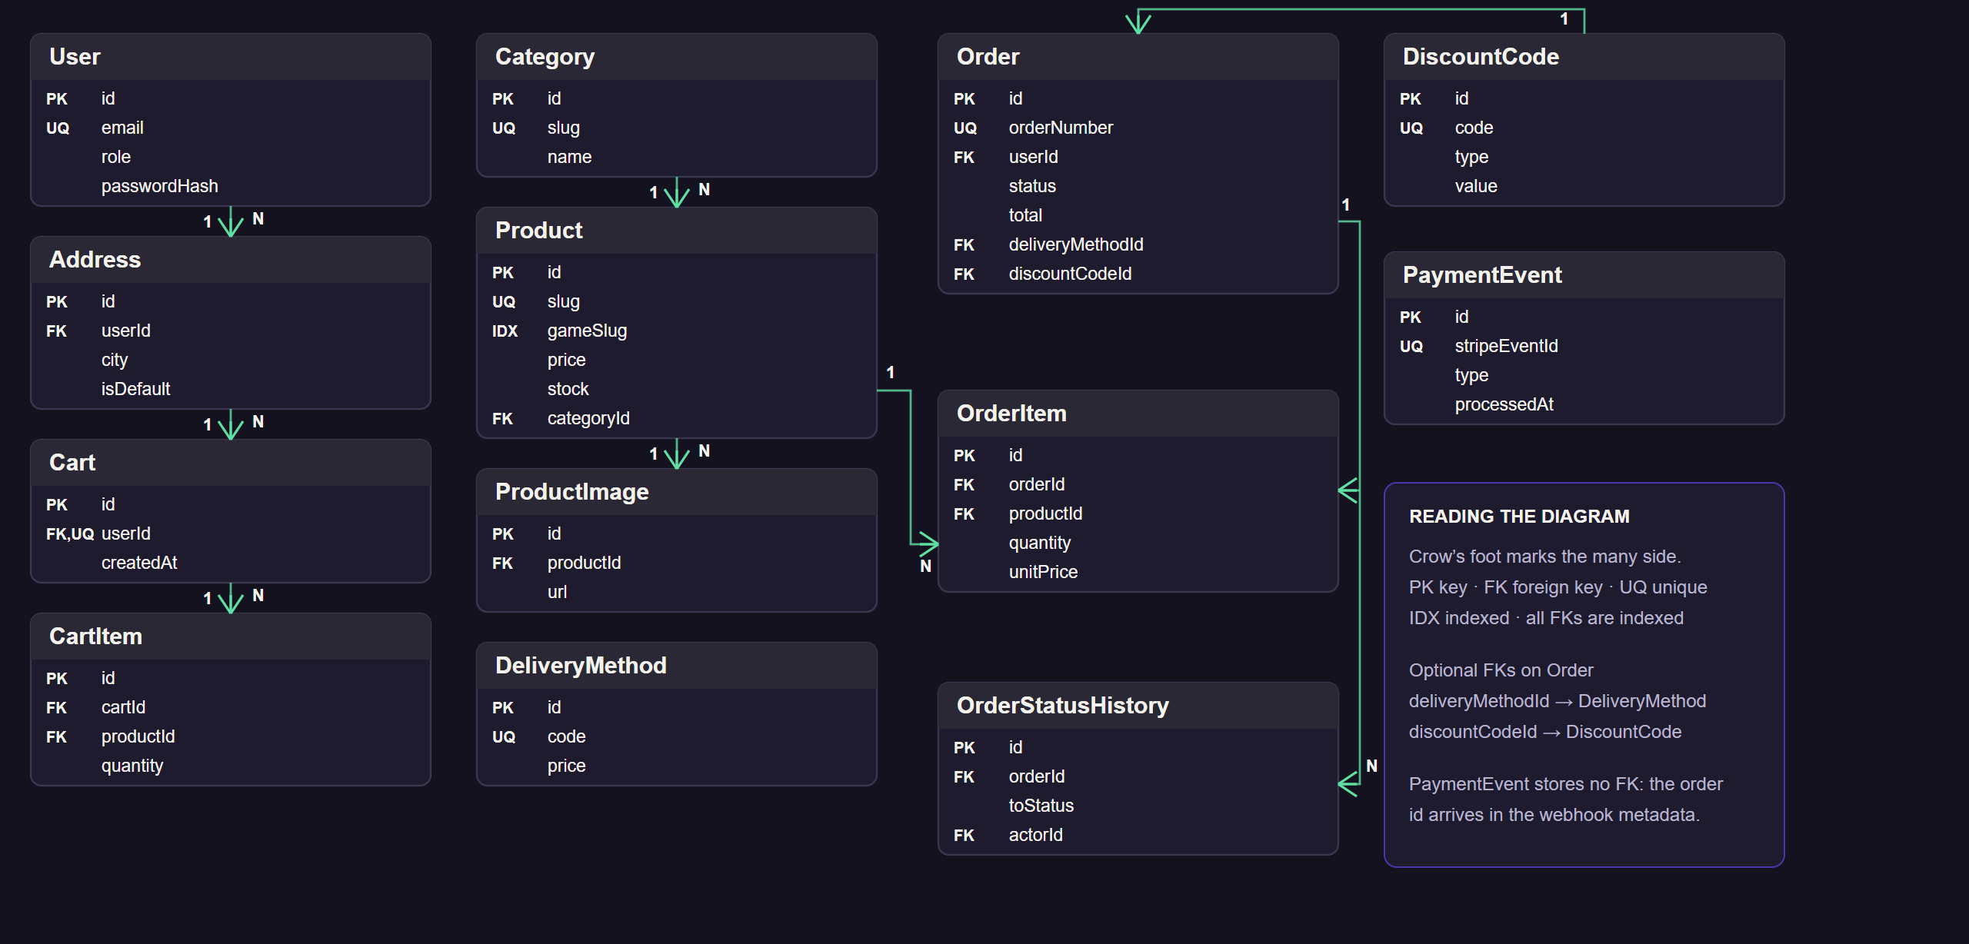
DATA MODEL
13 tables, one edition per product
ERD · PRISMA SCHEMA
7 / 15

Slide 8
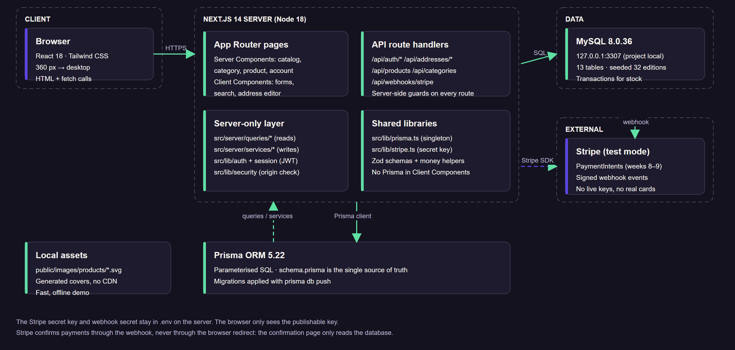
ARCHITECTURE
Next.js full stack, Prisma, MySQL, Stripe
ARCHITECTURE
8 / 15

Slide 9
API SURFACE
Implemented at P2
Method | Route | Access | Purpose
GET | /api/products | public | Paginated catalog, max 24/page; q, category, page, filters
GET | /api/products/[slug] | public | Product detail with images and sibling editions
GET | /api/categories | public | Categories with active edition counts
POST | /api/auth/register | public | Create account, hash password, start session
POST | /api/auth/login | public | Verify password, set signed session cookie
POST | /api/auth/logout | authenticated | Clear the session cookie
GET | /api/auth/me | authenticated | Current user
GET | /api/addresses | customer | List own addresses, default first
POST | /api/addresses | customer | Create address, first one becomes default
PATCH | /api/addresses/[id] | owner | Update address or promote to default
DELETE | /api/addresses/[id] | owner | Delete address, promote the next one
POST | /api/webhooks/stripe | Stripe signature | Verify, store once, mark order paid, decrement stock
Access levels are enforced on the server; hiding a link in the UI is never the control.
API · IMPLEMENTED
9 / 15

Slide 10
API SURFACE
Frozen for P3
Method | Route | Access
GET | /api/cart | customer
POST | /api/cart/items | customer
PATCH | /api/cart/items/[id] | owner
DELETE | /api/cart/items/[id] | owner
POST | /api/checkout | customer
GET | /api/orders | customer
GET | /api/orders/[id] | owner
GET | /api/delivery-methods | public
POST | /api/discounts/validate | customer
Method | Admin route | Access
GET/POST | /api/admin/products | ADMIN
PATCH/DELETE | /api/admin/products/[id] | ADMIN
POST | /api/admin/products/[id]/images | ADMIN
GET/POST | /api/admin/categories | ADMIN
PATCH/DELETE | /api/admin/categories/[id] | ADMIN
GET | /api/admin/orders | ADMIN
PATCH | /api/admin/orders/[id]/status | ADMIN
GET | /api/admin/dashboard | ADMIN · B4
GET/POST/PATCH | /api/admin/discounts | ADMIN · B5
Access model: requireUser for authenticated routes, requireRole('ADMIN') for the admin surface, ownership checks on address and order ids, and assertSameOrigin on every mutating browser request.
API · FROZEN FOR P3
10 / 15

Slide 11
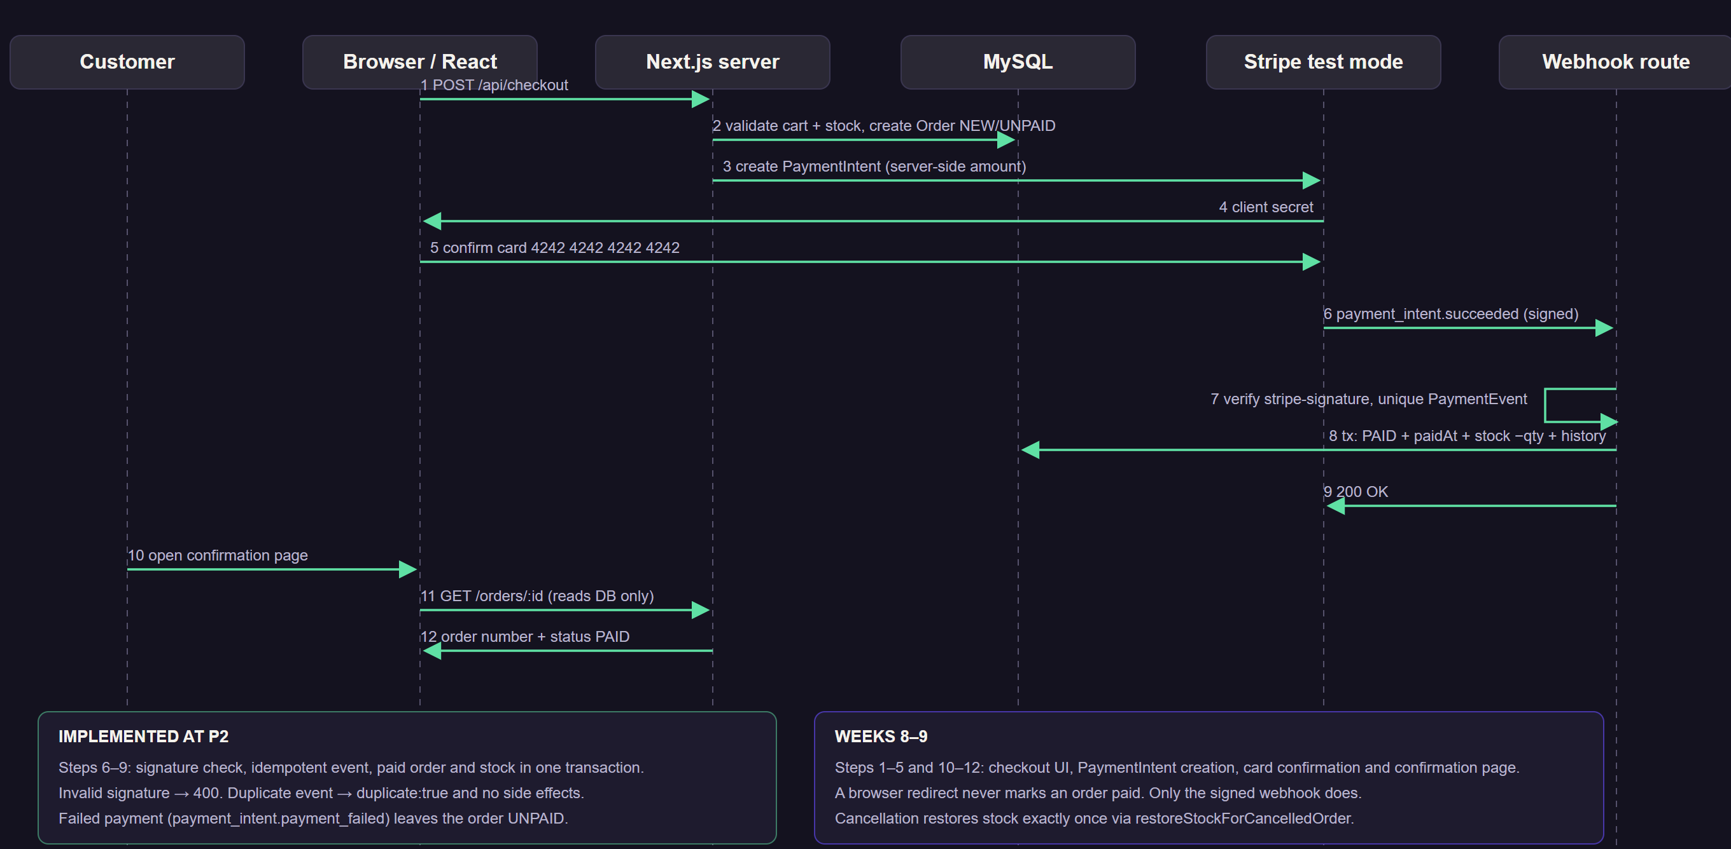
CRITICAL FLOW
Payment sequence
SEQUENCE · CHECKOUT → WEBHOOK → STOCK
11 / 15

Slide 12
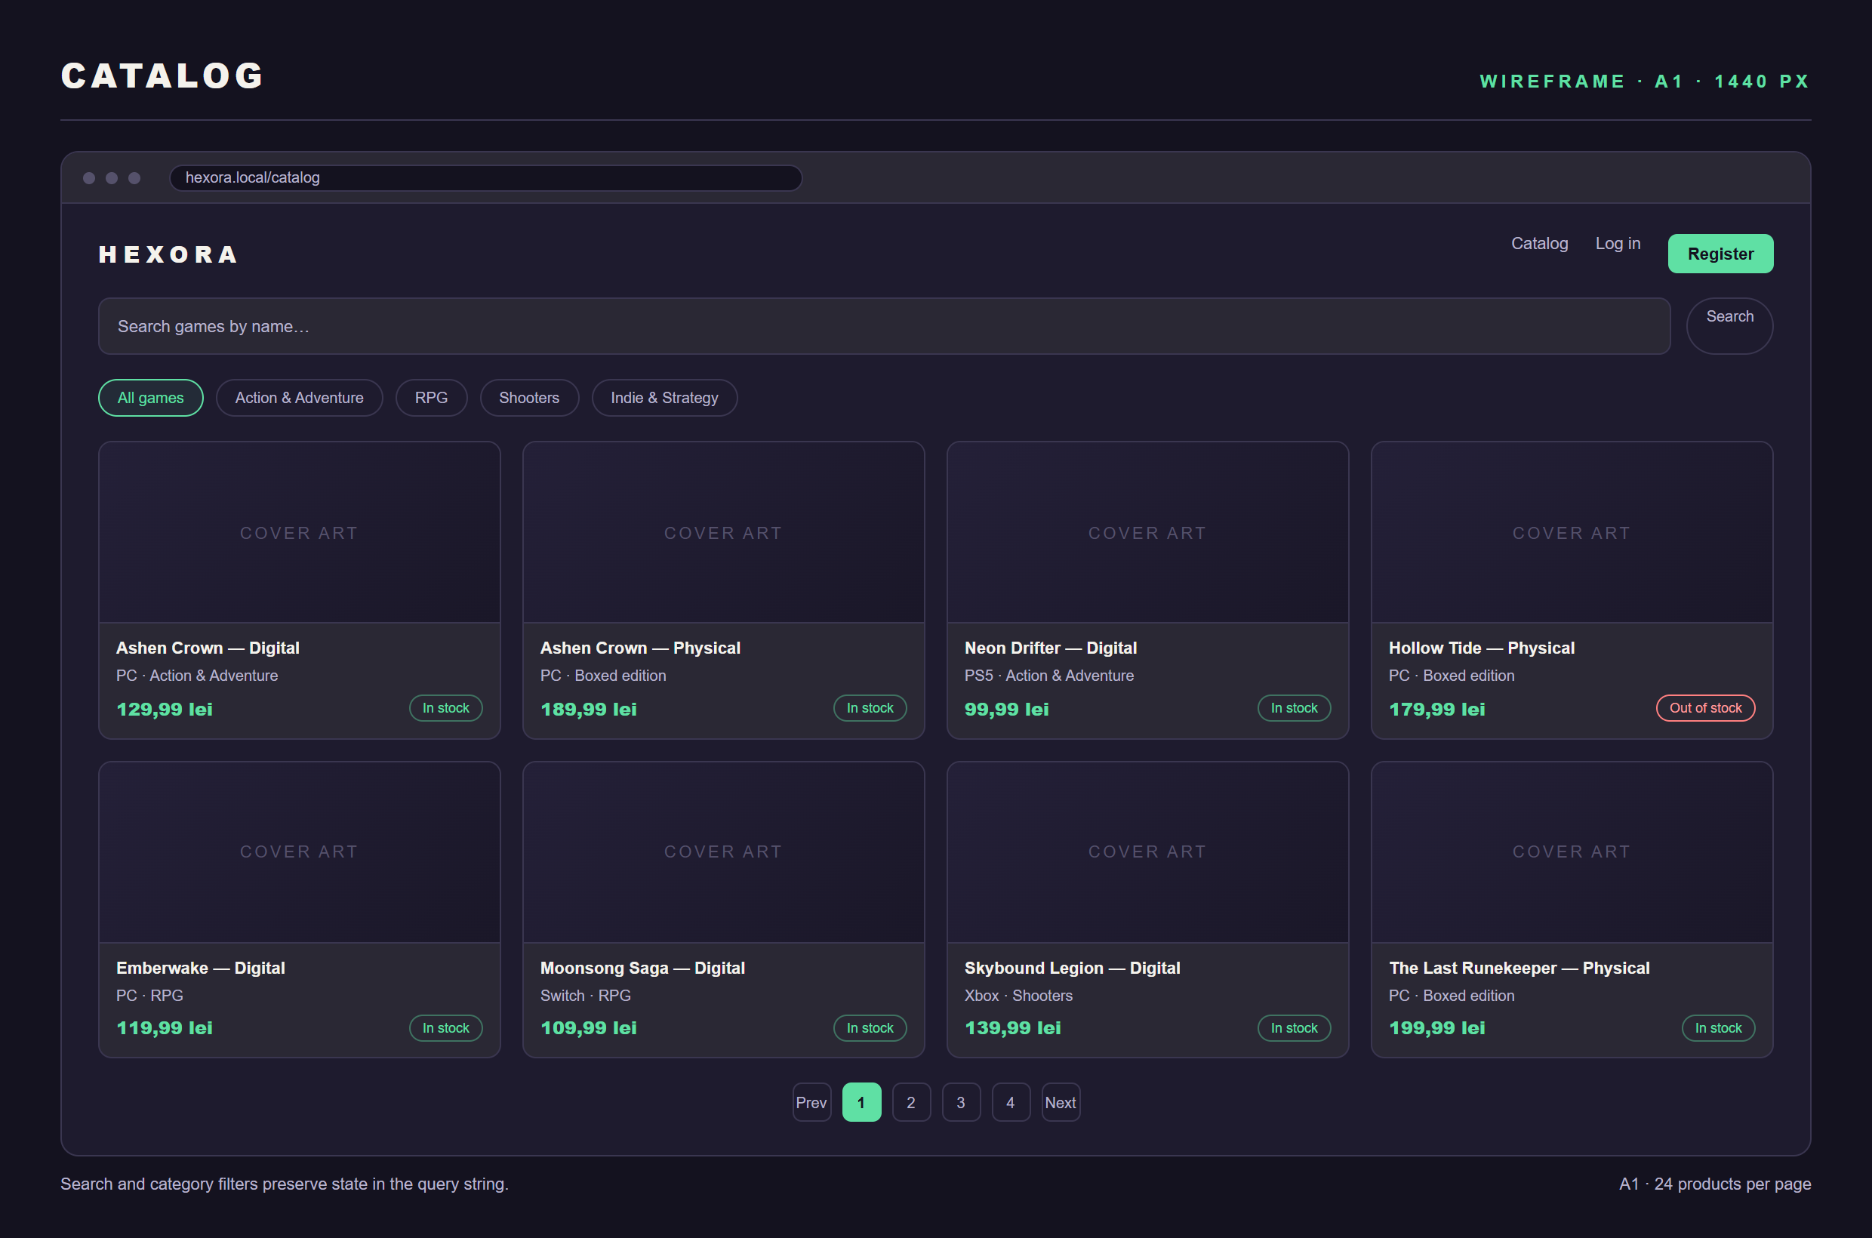
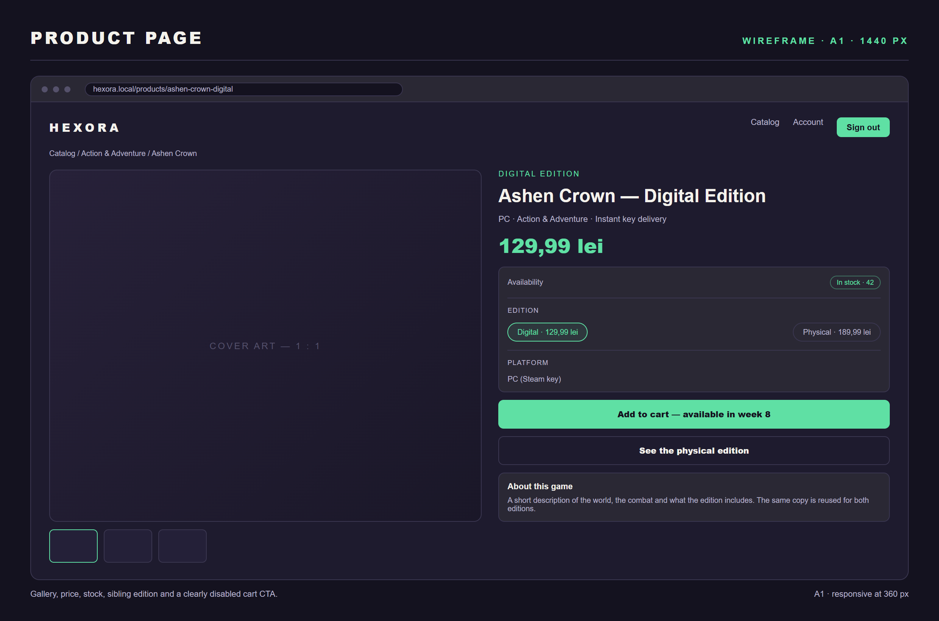
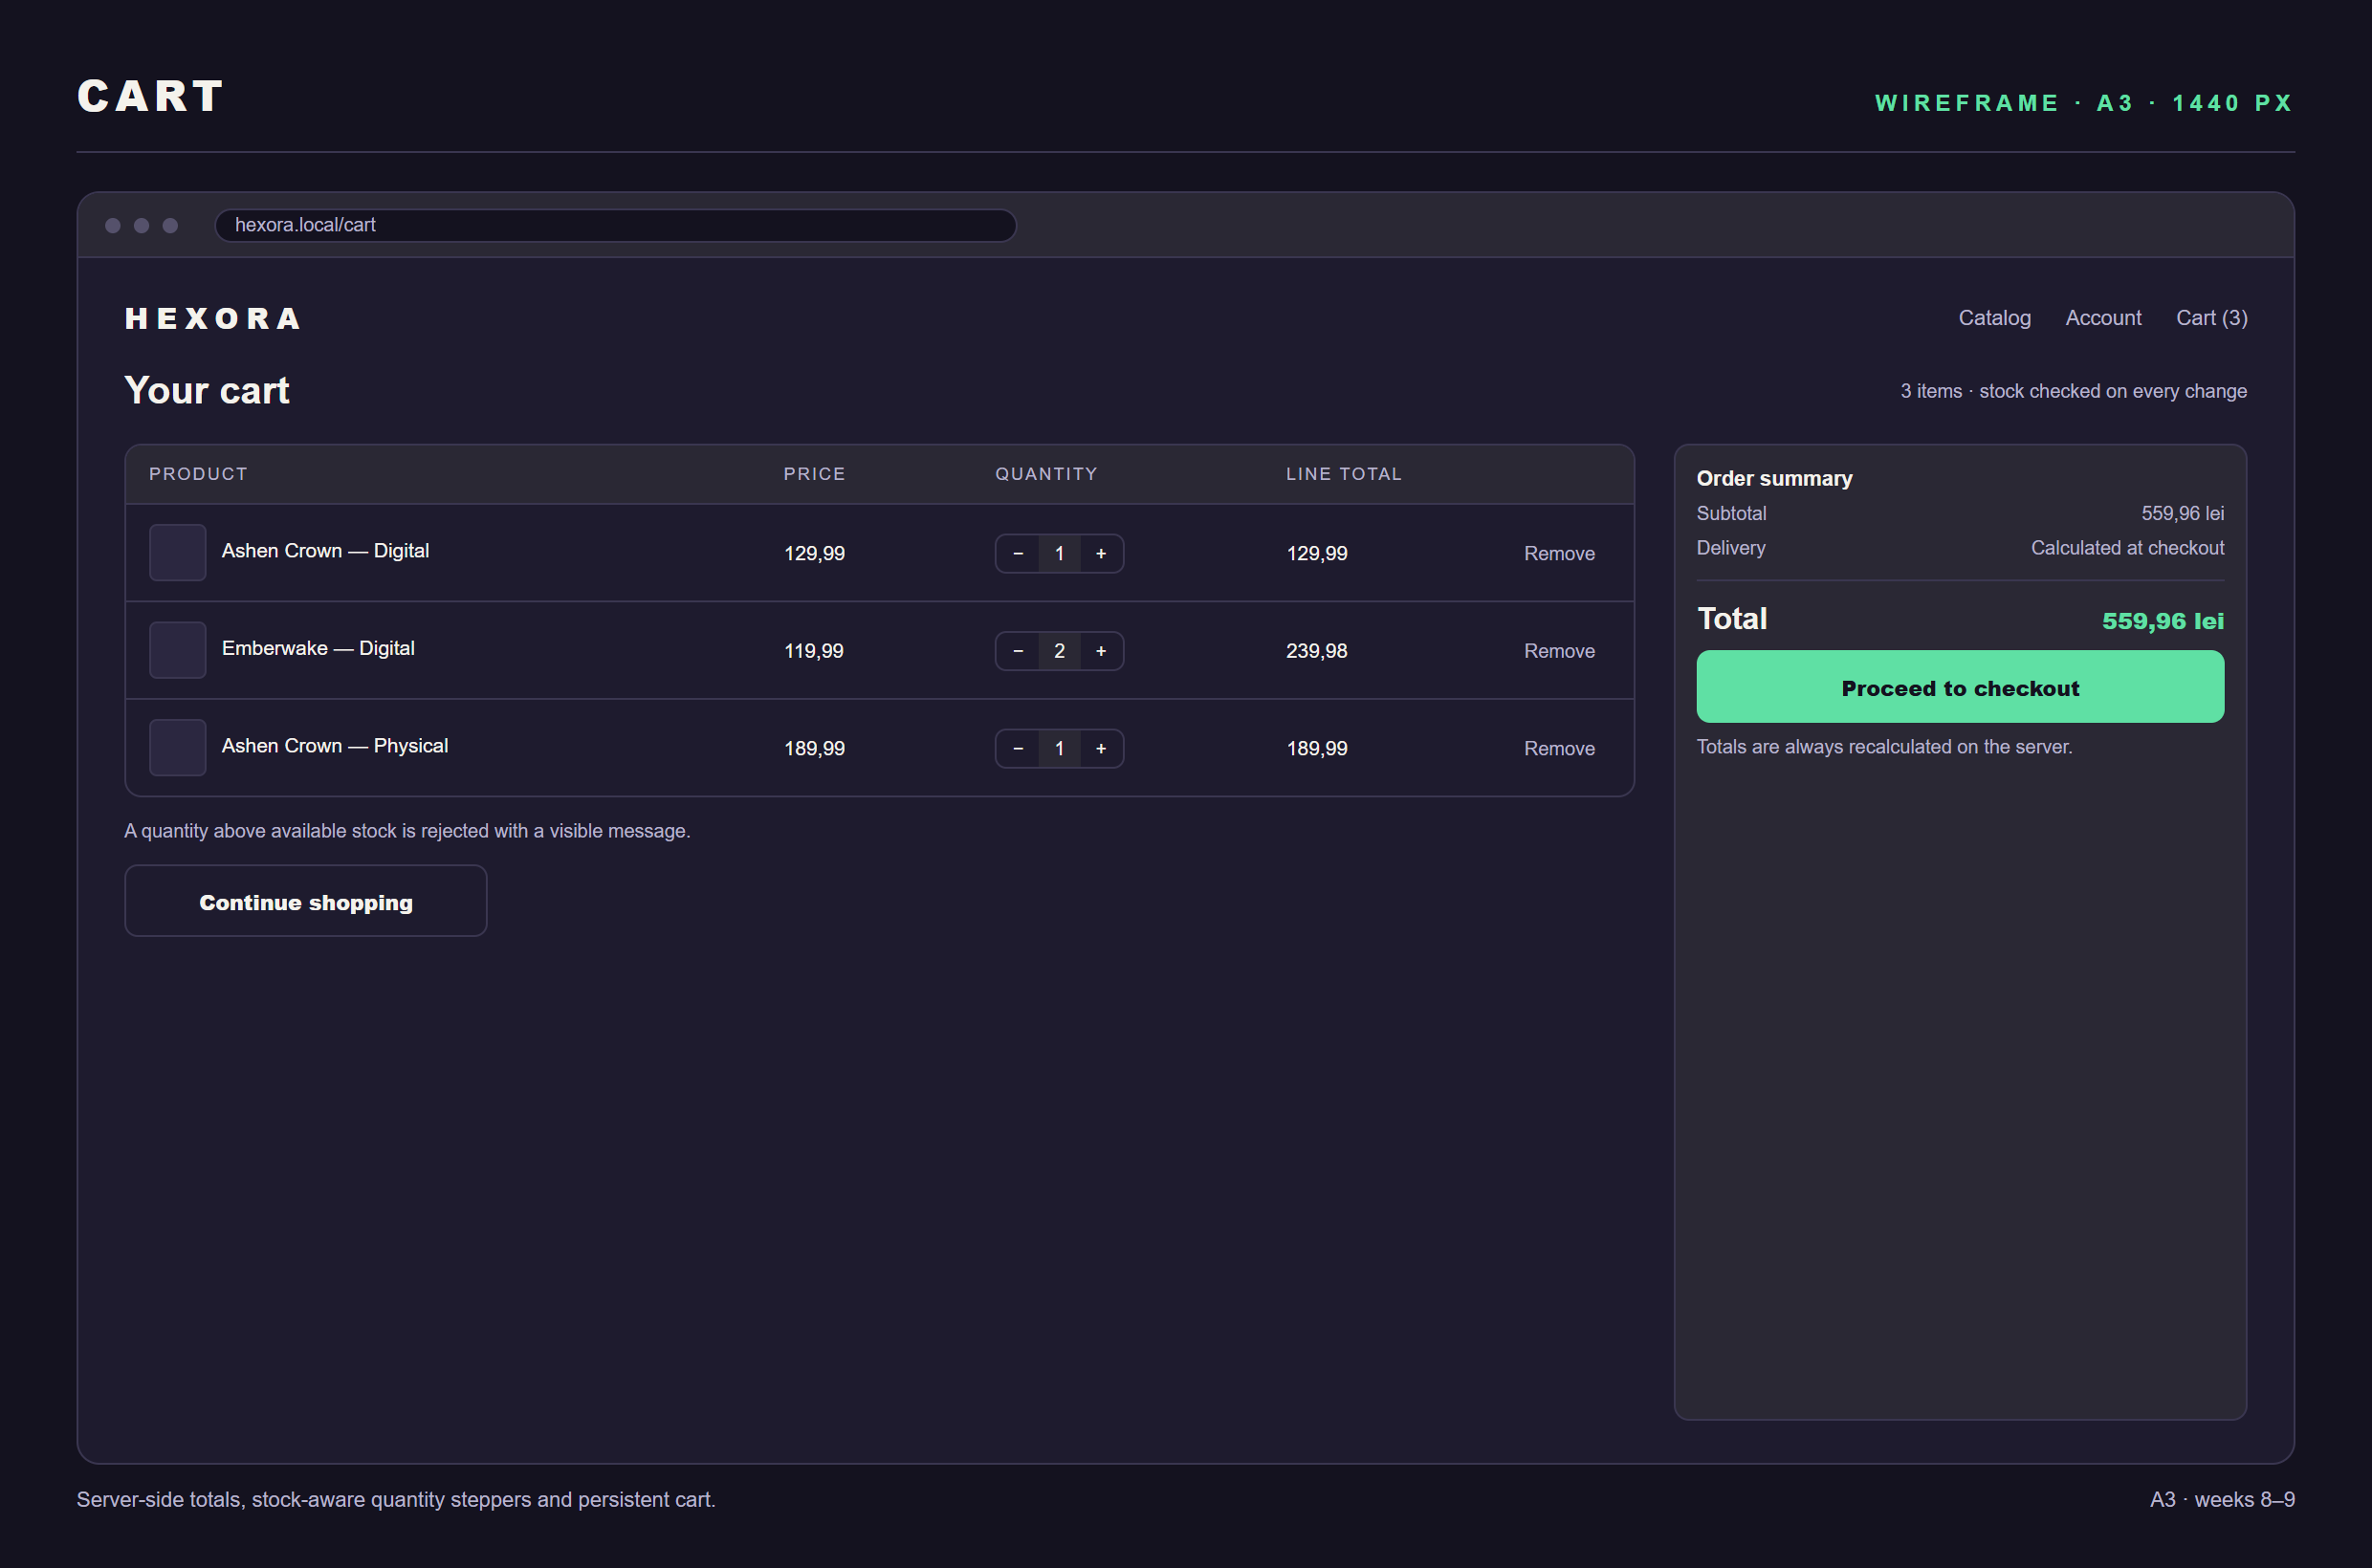
USER INTERFACE
Wireframes — catalog, product, cart
CATALOG · A1
PRODUCT · A1
CART · A3
Wide screens shown; every customer page keeps the same hierarchy at 360 px, with the product grid collapsing from four columns to two.
WIREFRAMES · 1 OF 2
12 / 15

Slide 13
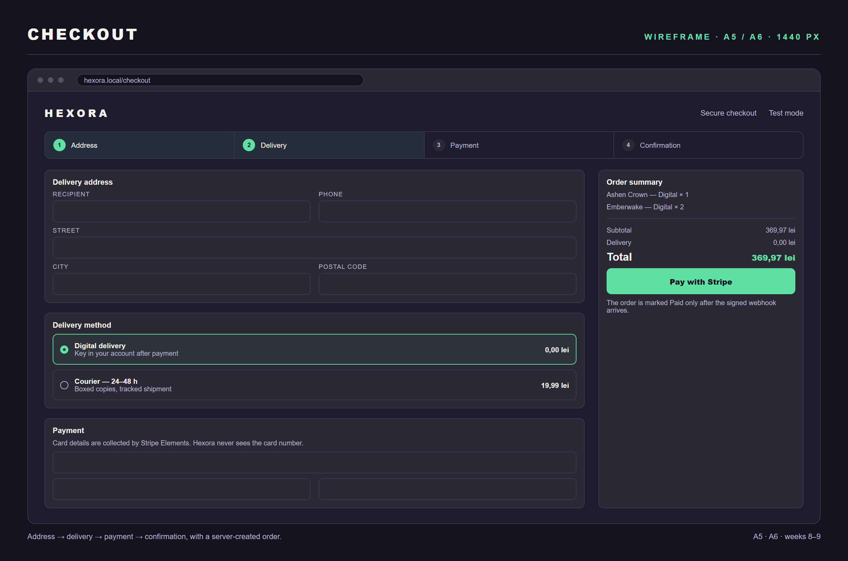
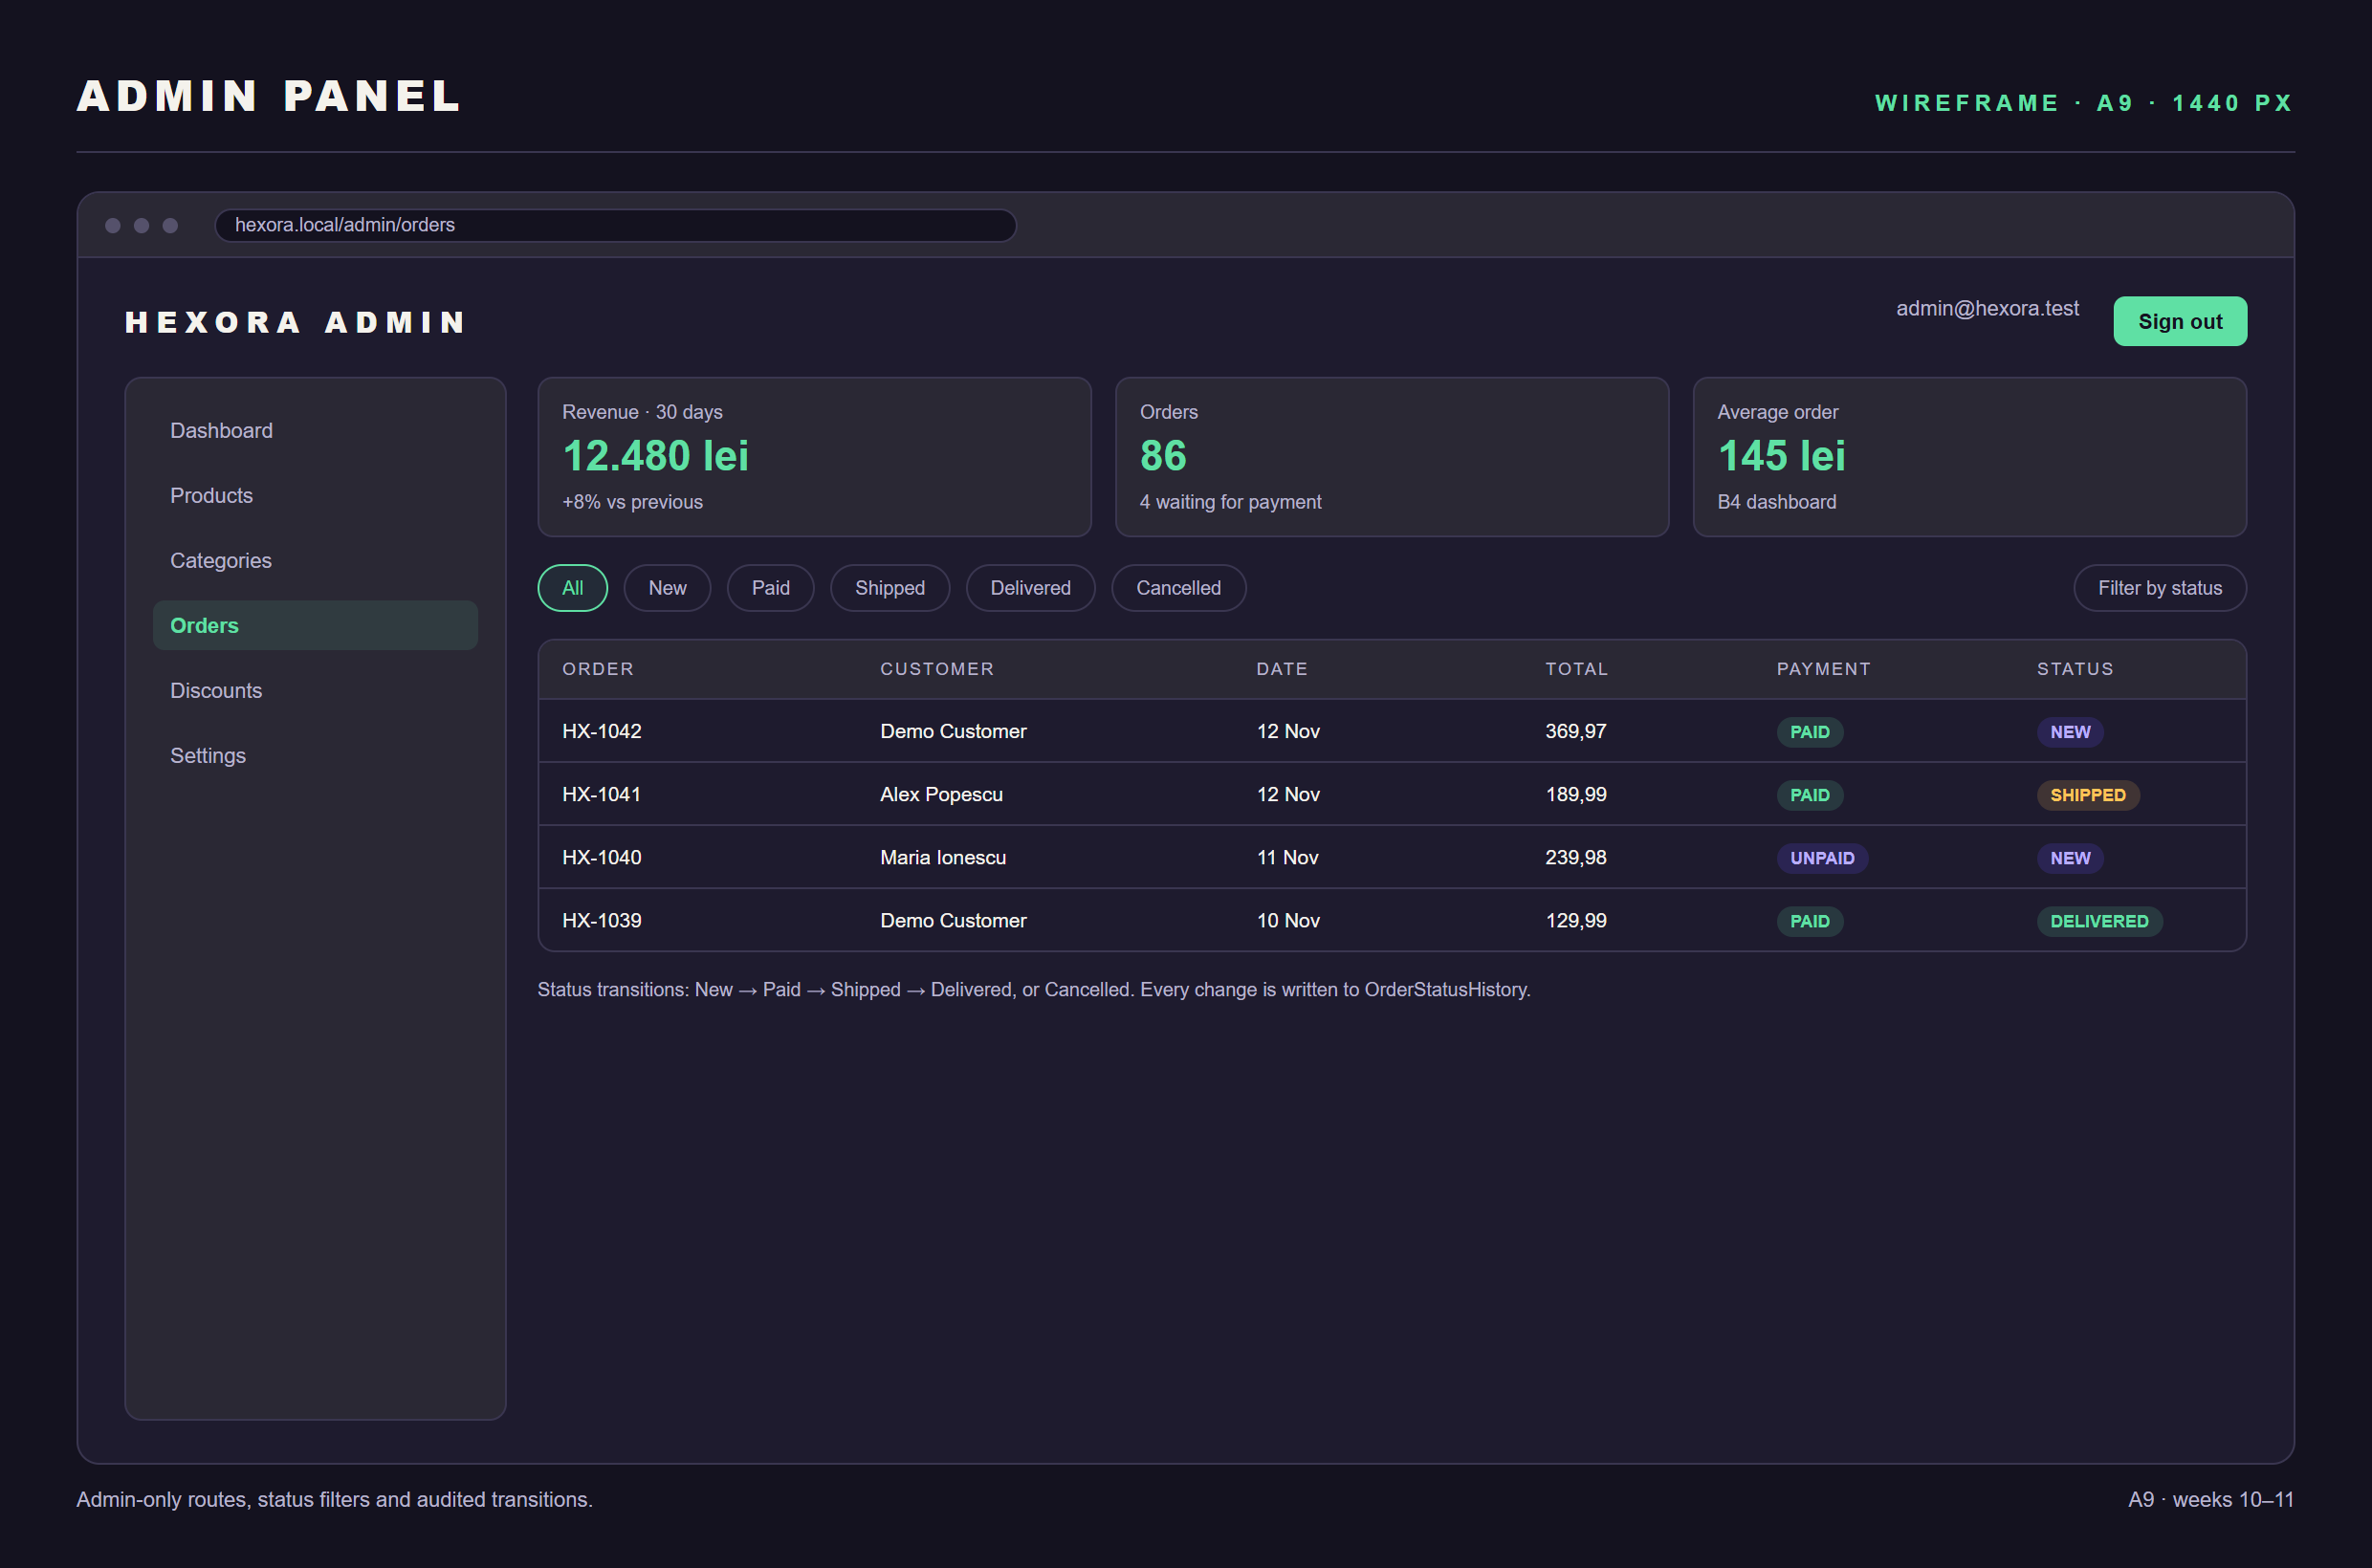
USER INTERFACE
Wireframes — checkout, administration
CHECKOUT · A5 / A6
ADMINISTRATION · A9
Checkout makes the delivery cost and the payment state explicit. The admin panel exposes role-guarded CRUD, status filters and the audited transition path.
WIREFRAMES · 2 OF 2
13 / 15

Slide 14
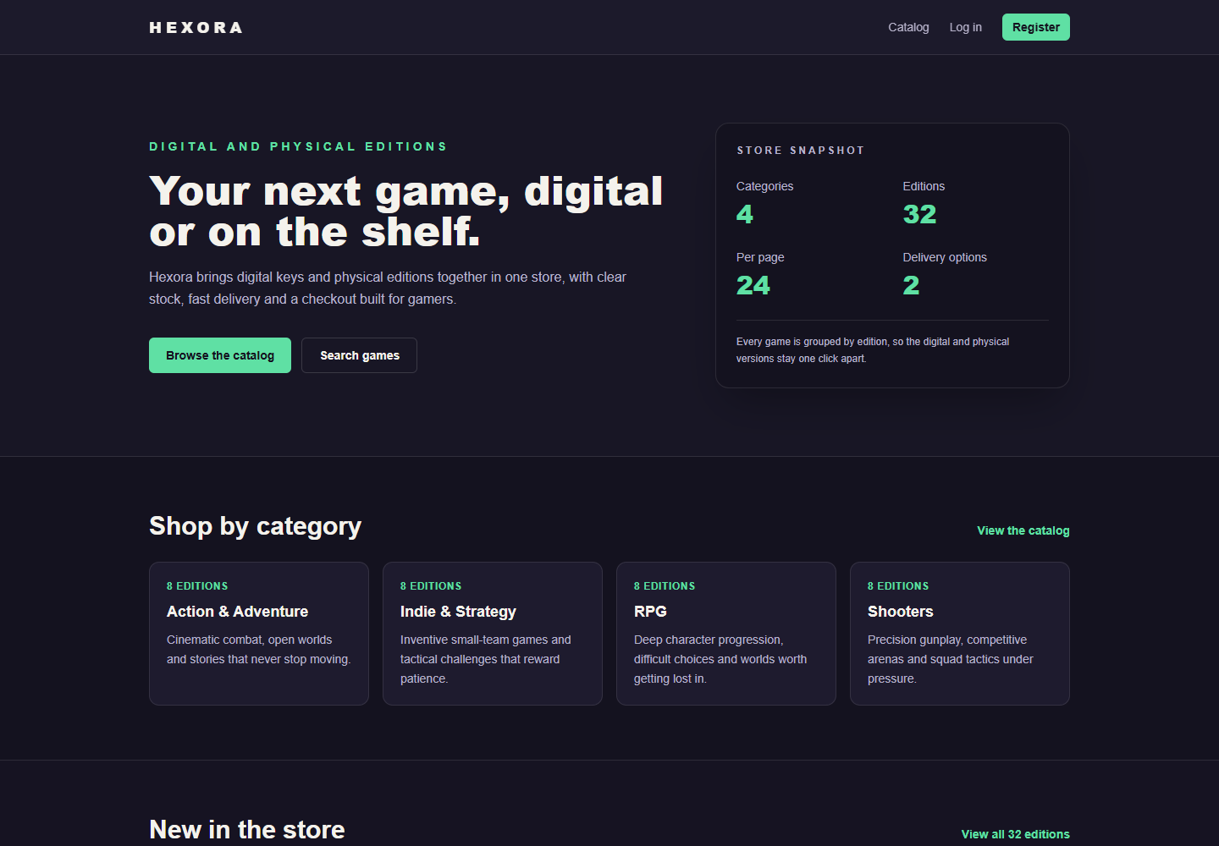
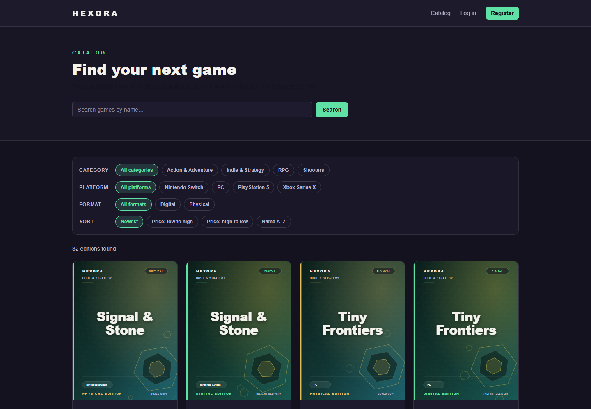
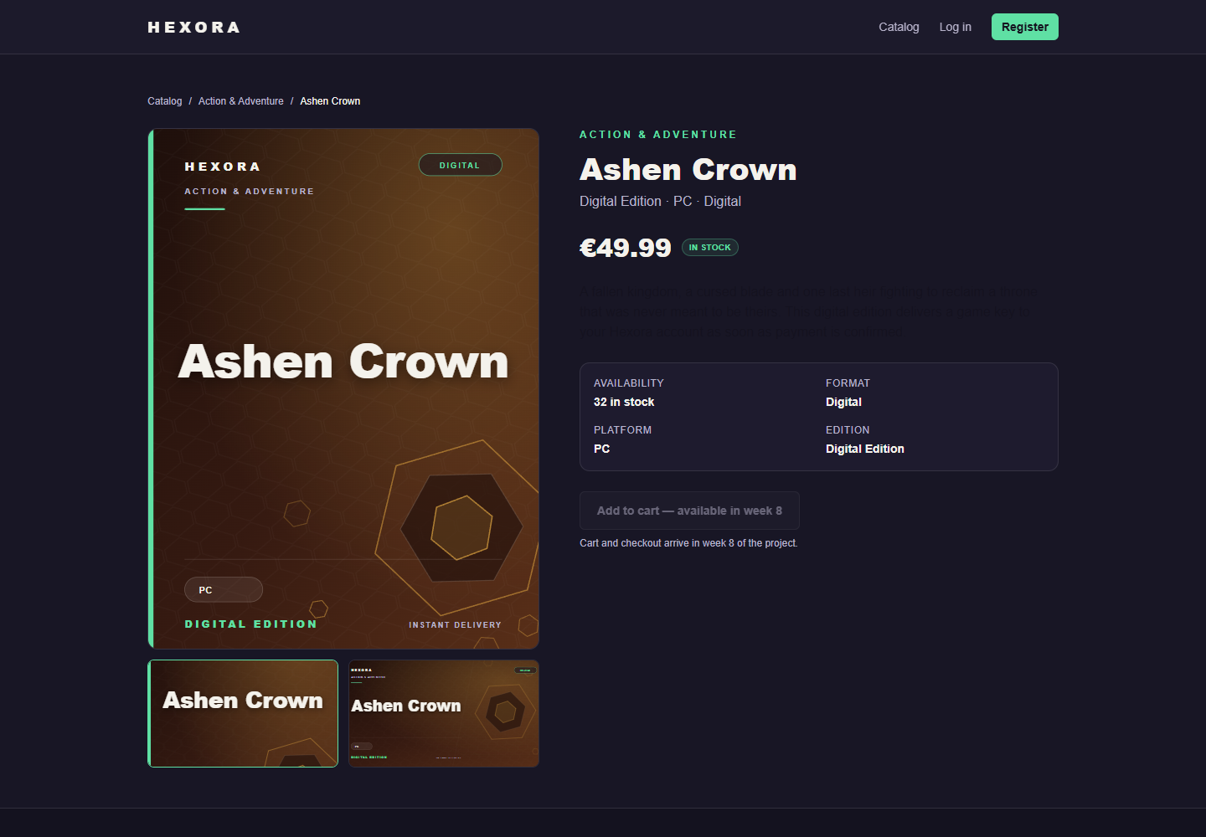
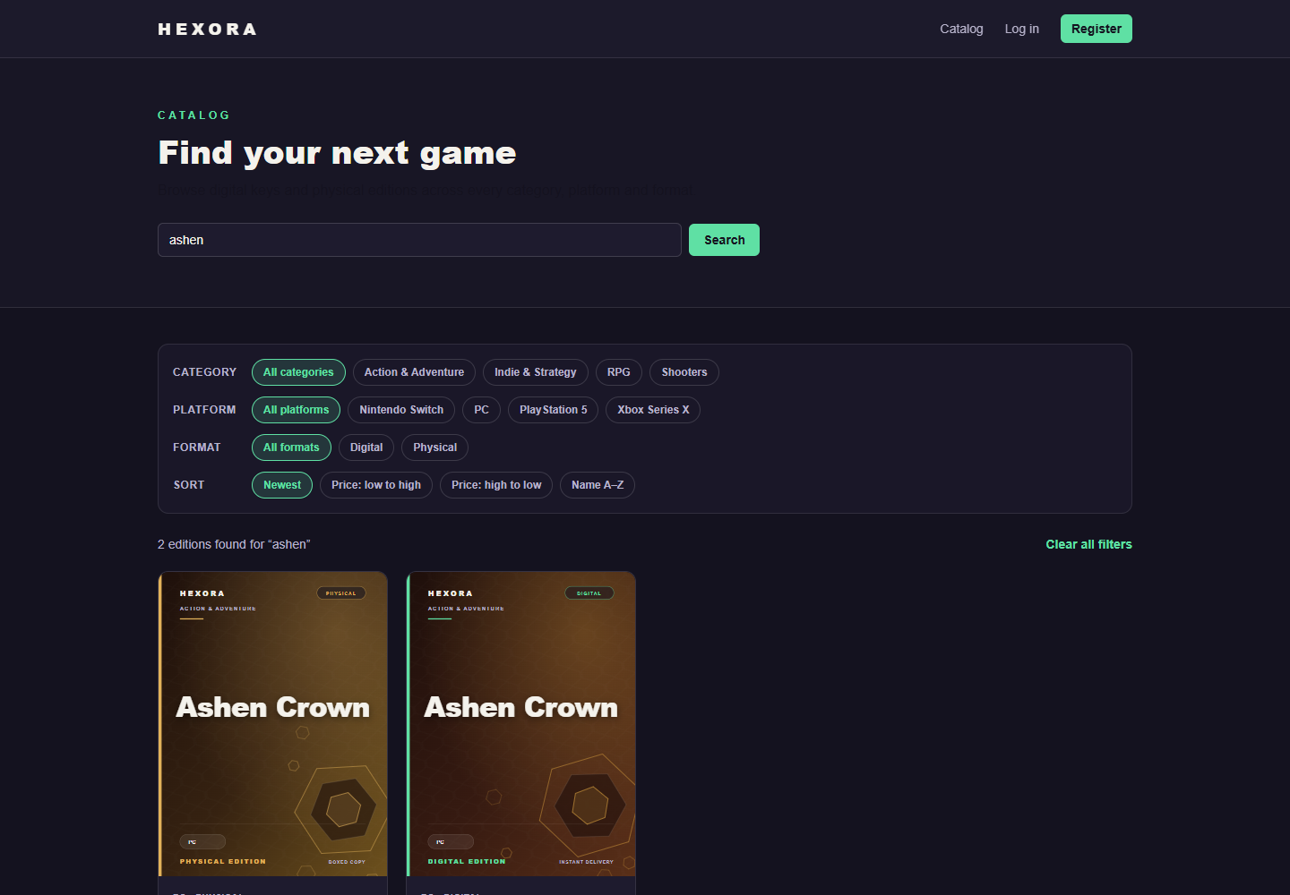
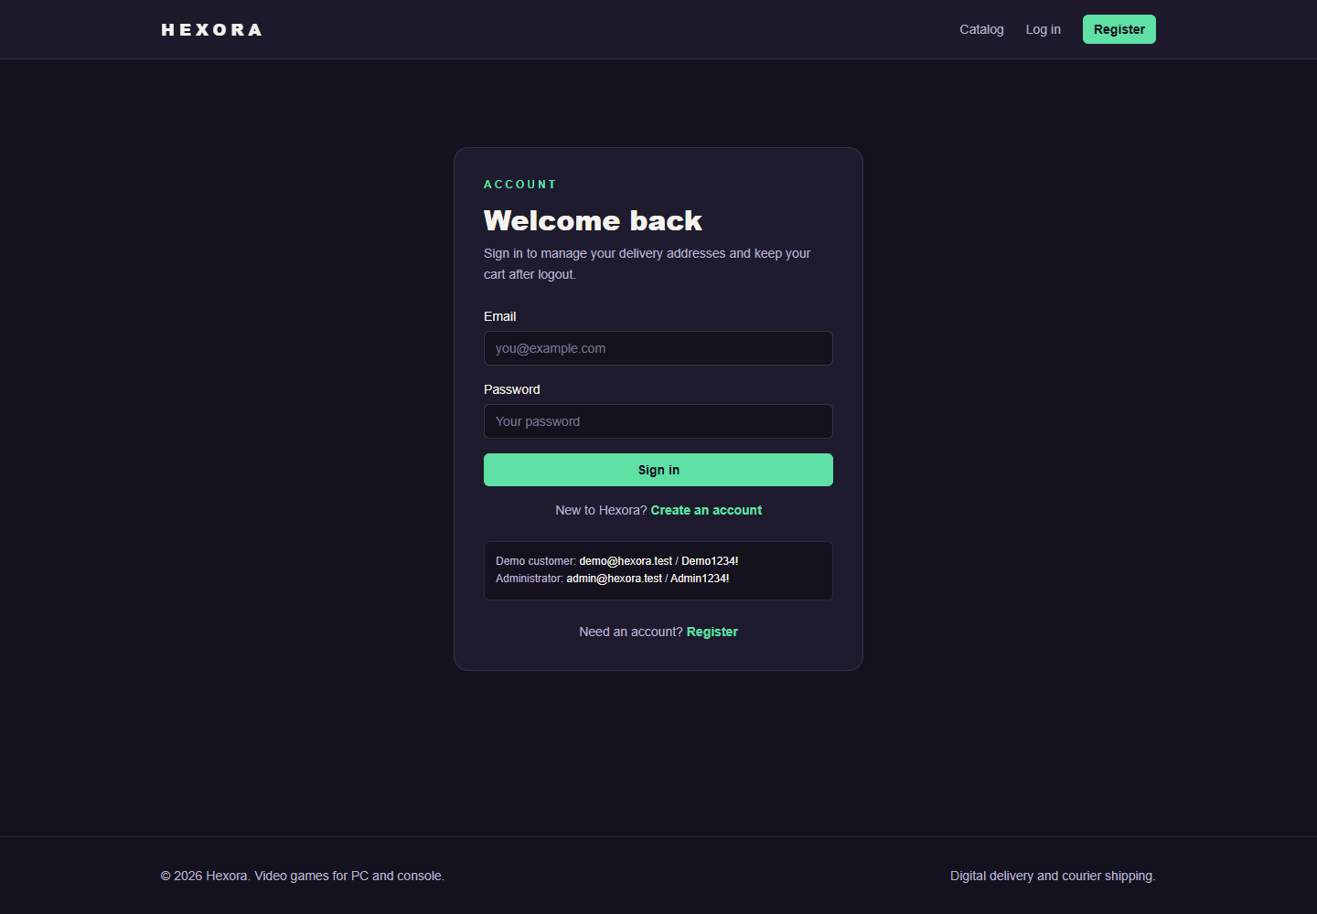
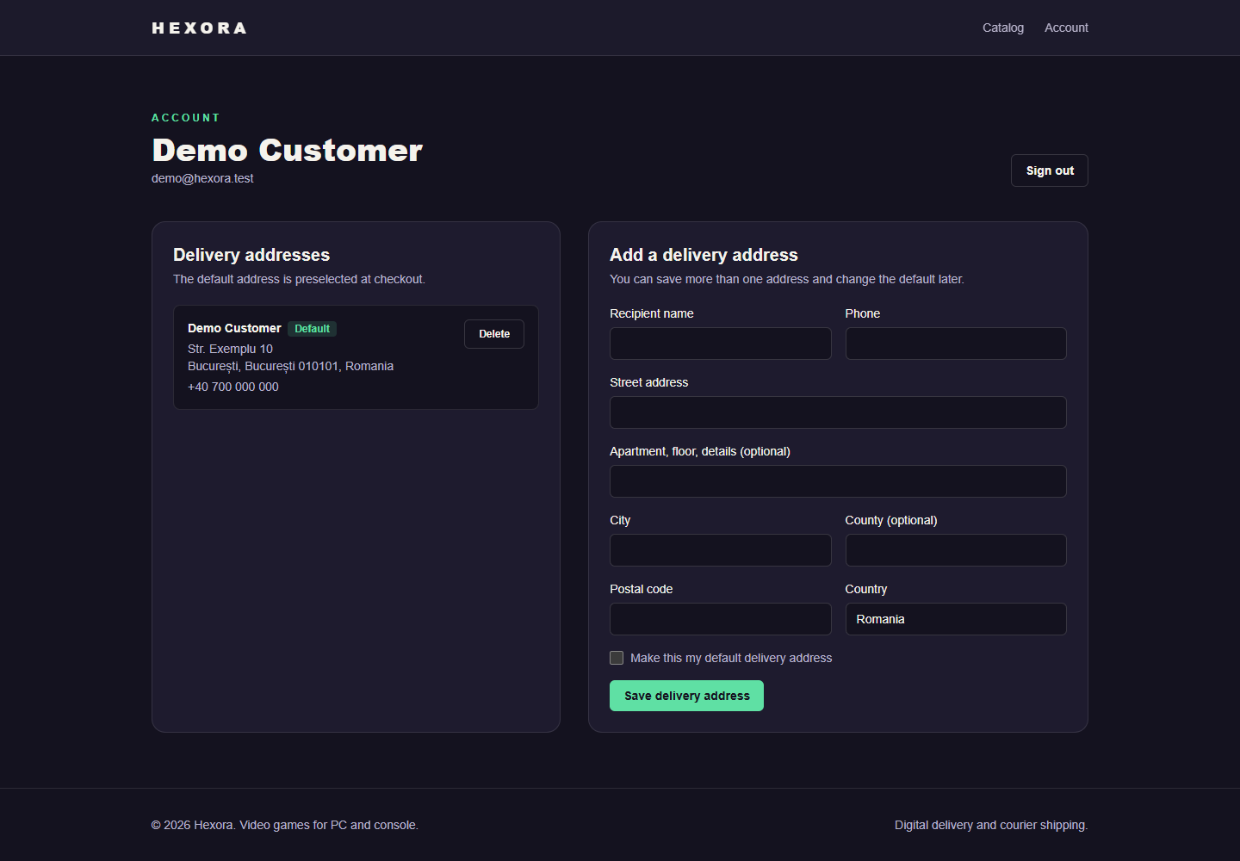
WORKING PROTOTYPE
Live data from MySQL
HOME · 1440 PX
CATALOG · A1
PRODUCT · SIBLINGS
SEARCH · A2
LOGIN · A4
ACCOUNT · ADDRESSES
PROTOTYPE · SEEDED DATABASE
14 / 15

Slide 15
PLAN, RISKS AND QUESTIONS
Weeks 8–12
Week | Work | Owner | Status
3 | P1, repository, README | All | done
4 | ERD, endpoints, wireframes | All | done
5 | Seed data · A1 catalog · A4 accounts | Cosmin, Iulian | done
6 | A2 search · Stripe setup · login prototype | Cosmin, Rares | done
7 | P2 specification and live prototype | All | done
8 | A3 cart · A5 checkout | Iulian, Rares | next
9 | A6 confirmation · A7 stock · A8 history | Rares, Iulian | planned
10 | A9 admin panel · A10 security | Cosmin, Rares | planned
11 | A11 responsive · A12 tests · B4 + B5 | Cosmin, Iulian | planned
12 | P3 fixes, backup video, final README | All | planned
Risks we watch
Payments & stock · webhook-first, conditional updates, transaction tests.
Integration · frozen contracts and small merges.
Scope · required features first, freeze in week 11.
Thank you — questions
Repository, branch and PR links are in the README and the specification document.
Branches 3 feature branches, one author each
Integration p2/integration → main · tag P2
Docs README · schedule · PR bodies
SCHEDULE · RISKS · Q&A
15 / 15

